Slide 1

MATH 285 Week 7
DI 2

Slide 2
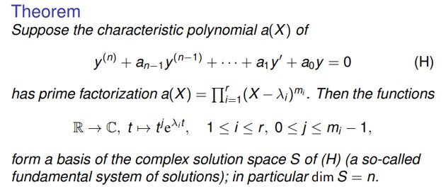
Recap for Higher Order Ordinary Differential Equation

Slide 3

Inhomogeneous Case

Slide 4
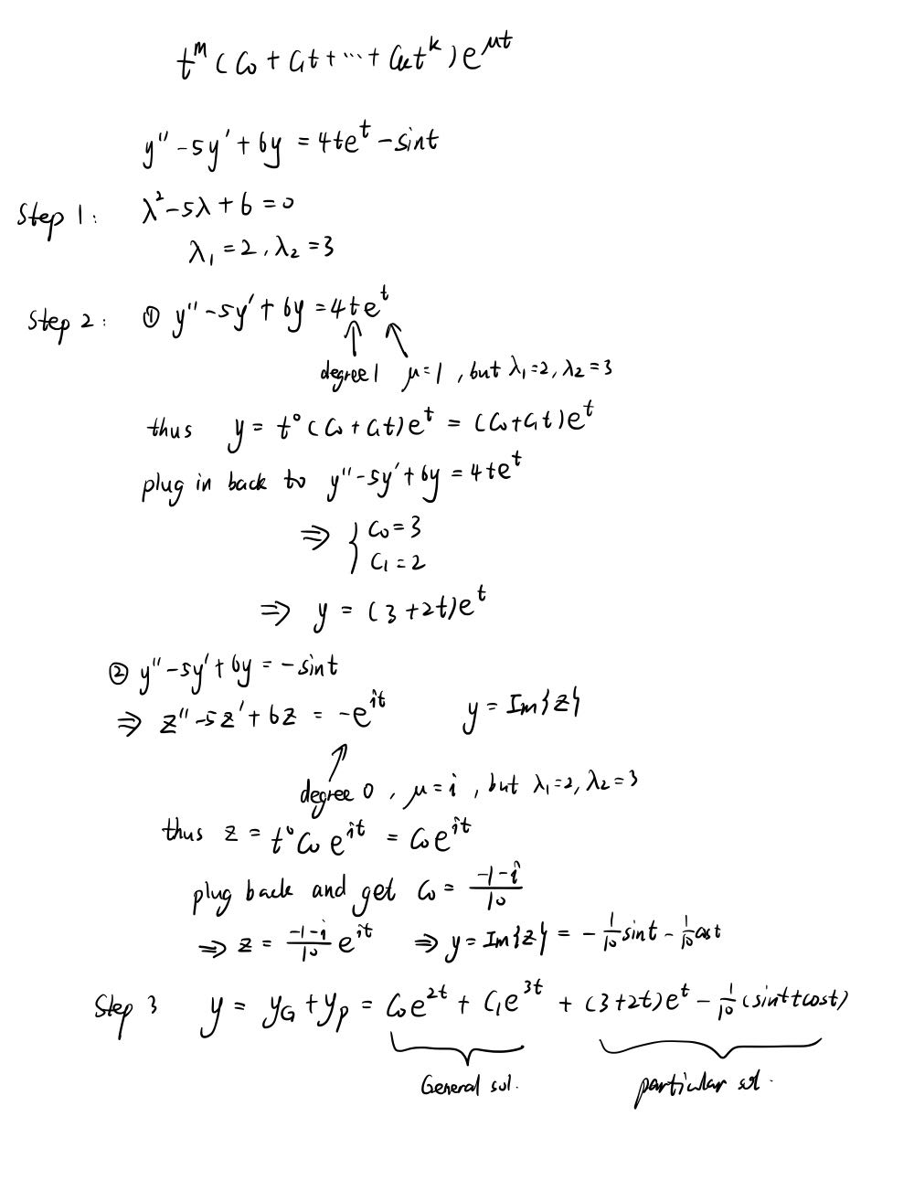

Slide 5
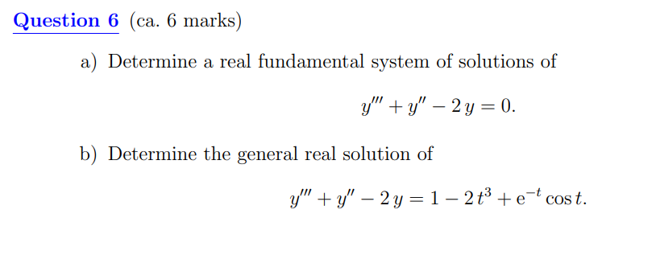
2022SP Final

Slide 6



Slide 7
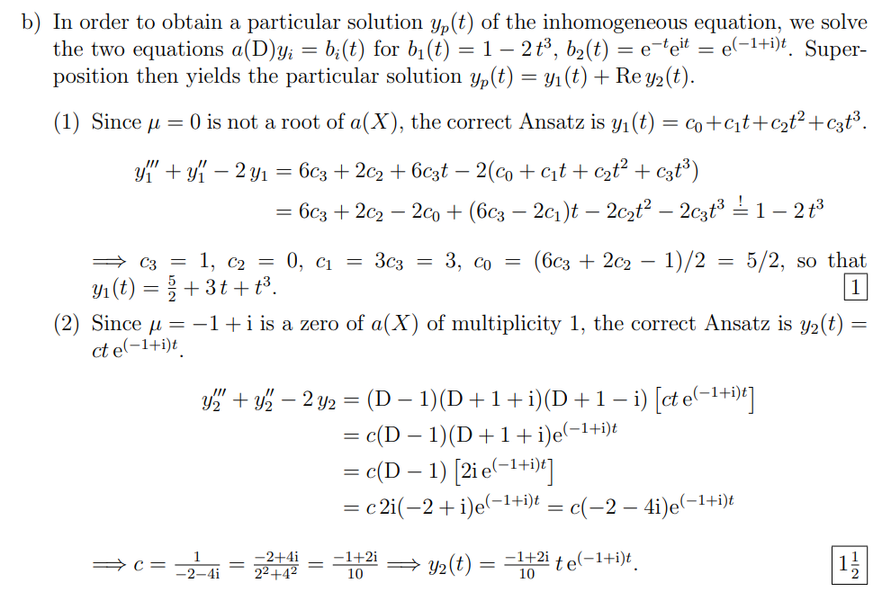

Slide 8


